Slide 1
KNOWLEDGE REPRESENTATION

Slide 2
Humans are best at understanding, reasoning, and interpreting knowledge. Human knows things, which is knowledge and as per their knowledge they perform various actions in the real world.
But how machines do all these things comes under knowledge representation and reasoning.
Knowledge representation and reasoning (KR, KRR) is the part of Artificial intelligence which concerned with AI agents thinking and how thinking contributes to intelligent behavior of agents.
It is responsible for representing information about the real world so that a computer can understand and can utilize this knowledge to solve the complex real world problems such as diagnosis a medical condition or communicating with humans in natural language.
Knowledge representation is not just storing data into some database, but it also enables an intelligent machine to learn from that knowledge and experiences so that it can behave intelligently like a human.

Slide 3
What to Represent:
Following are the kind of knowledge which needs to be represented in AI systems:
Object: All the facts about objects in our world domain. E.g., Guitars contains strings, trumpets are brass instruments.
Events: Events are the actions which occur in our world.
Performance: It describe behavior which involves knowledge about how to do things.
Meta-knowledge: It is knowledge about what we know.
Facts: Facts are the truths about the real world and what we represent.
Knowledge-Base: The central component of the knowledge-based agents is the knowledge base. It is represented as KB. The Knowledgebase is a group of the Sentences (Here, sentences are used as a technical term and not identical with the English language).

Slide 4
Types of knowledge
1. Declarative Knowledge:
Declarative knowledge is to know about something.
It includes concepts, facts, and objects.
It is also called descriptive knowledge and expressed in declarative sentences.
It is simpler than procedural language.
2. Procedural Knowledge
It is also known as imperative knowledge.
Procedural knowledge is a type of knowledge which is responsible for knowing how to do something.
It can be directly applied to any task.
It includes rules, strategies, procedures, agendas, etc.
Procedural knowledge depends on the task on which it can be applied.

Slide 5
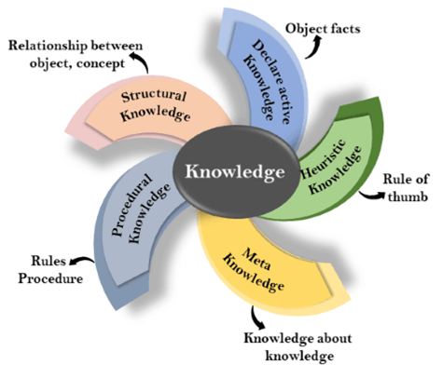

Slide 6
3. Meta-knowledge:
Knowledge about the other types of knowledge is called Meta-knowledge.
4. Heuristic knowledge:
Heuristic knowledge is representing knowledge of some experts in a filed or subject.
Heuristic knowledge is rules of thumb based on previous experiences, awareness of approaches, and which are good to work but not guaranteed.
5. Structural knowledge:
Structural knowledge is basic knowledge to problem-solving.
It describes relationships between various concepts such as kind of, part of, and grouping of something.
It describes the relationship that exists between concepts or objects.

Slide 7
The relation between knowledge and intelligence:
Knowledge plays an important role in demonstrating intelligent behavior in AI agents. An agent is only able to accurately act on some input when he has some knowledge or experience about that input.
Let's suppose if you met some person who is speaking in a language which you don't know, then how you will able to act on that. The same thing applies to the intelligent behavior of the agents.
As we can see in below diagram, there is one decision maker which act by sensing the environment and using knowledge. But if the knowledge part will not present then, it cannot display intelligent behavior.

Slide 8
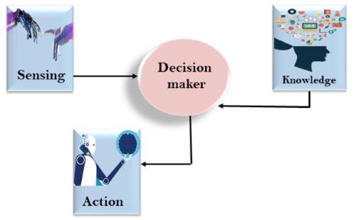

Slide 9
AI knowledge cycle:
An Artificial intelligence system has the following components for displaying intelligent behavior:
Perception
Learning
Knowledge Representation and Reasoning
Planning
Execution
The above diagram is showing how an AI system can interact with the real world and what components help it to show intelligence.
Perception :-Perception component by which it retrieves information from its environment. It can be visual, audio or another form of sensory input.
Learning :-learning component is responsible for learning from data captured by Perception comportment.

Slide 10
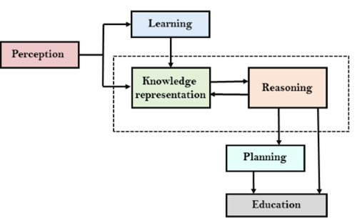

Slide 11
the main components are knowledge representation and Reasoning. These two components are involved in showing the intelligence in machine-like humans. These two components are independent with each other but also coupled together.
The planning and execution depend on analysis of Knowledge representation and reasoning.
Techniques of knowledge representation
There are mainly four ways of knowledge representation which are given as follows:
Logical Representation
Semantic Network Representation
Frame Representation
Production Rules

Slide 12
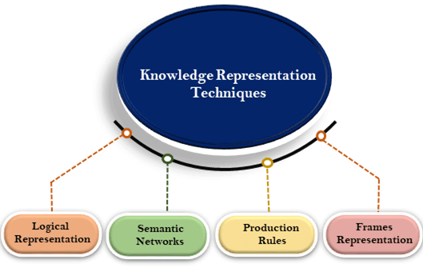

Slide 13
Logical representation is a language with some concrete rules which deals with propositions and has no ambiguity (two or more possible ways) in representation. Logical representation means drawing a conclusion based on various conditions.
This representation lays down some important communication rules. It consists of precisely defined syntax and semantics which supports the sound inference. Each sentence can be translated into logics using syntax and semantics.
Syntax:
Syntaxes are the rules which decide how we can construct legal sentences in the logic.
It determines which symbol we can use in knowledge representation.
How to write those symbols.

Slide 14
Semantics:
Semantics are the rules by which we can interpret(explain) the sentence in the logic.
Semantic also involves assigning a meaning to each sentence.
Logical representation can be categorised into mainly two logics:
Propositional Logics
Predicate logics
Advantages of logical representation:
Logical representation enables us to do logical reasoning.
Logical representation is the basis for the programming languages.
Disadvantages of logical Representation:
Logical representations have some restrictions and are challenging to work with.
Logical representation technique may not be very natural, and inference may not be so efficient.

Slide 15
Propositional logic in Artificial intelligence
Propositional logic (PL) is the simplest form of logic where all the statements are made by propositions. A proposition is a declarative statement which is either true or false. It is a technique of knowledge representation in logical and mathematical form.
Example:
a) It is Sunday.
b) The Sun rises from West (False proposition)
c) 3+3= 7(False proposition)
d) 5 is a prime number.
Following are some basic facts about propositional logic:
Propositional logic is also called Boolean logic as it works on 0 and 1.
In propositional logic, we use symbolic variables to represent the logic, and we can use any symbol for a representing a proposition, such A, B, C, P, Q, R, etc.

Slide 16
Propositions can be either true or false, but it cannot be both.
Propositional logic consists of an object, relations or function, and logical connectives.
These connectives are also called logical operators
A proposition formula which is always true is called tautology, and it is also called a valid sentence.
A proposition formula which is always false is called Contradiction.
A proposition formula which has both true and false values is called
Statements which are questions, commands, or opinions are not propositions such as "Where is Rohini", "How are you", "What is your name", are not propositions.

Slide 17
Syntax of propositional logic:
The syntax of propositional logic defines the allowable sentences for the knowledge representation. There are two types of Propositions:
Atomic Propositions
Compound propositions
Atomic Proposition: Atomic propositions are the simple propositions. It consists of a single proposition symbol. These are the sentences which must be either true or false.
Example:
a) 2+2 is 4, it is an atomic proposition as it is a true fact.
b) "The Sun is cold" is also a proposition as it is a false fact.

Slide 18
Compound proposition: Compound propositions are constructed by combining simpler or atomic propositions, using parenthesis and logical connectives.
Example:
a) "It is raining today, and street is wet."
b) "Ankit is a doctor, and his clinic is in Mumbai."
Logical Connectives:
Logical connectives are used to connect two simpler propositions or representing a sentence logically. We can create compound propositions with the help of logical connectives. There are mainly five connectives, which are given as follows:
1. Negation: A sentence such as ¬ P is called negation of P. A literal can be either Positive literal or negative literal.
2. Conjunction: A sentence which has ∧ connective such as, P ∧ Q is called a conjunction. Example: Rohan is intelligent and hardworking. It can be written as, P= Rohan is intelligent, Q= Rohan is hardworking. → P∧ Q.

Slide 19
3. Disjunction: A sentence which has ∨ connective, such as P ∨ Q. is called disjunction, where P and Q are the propositions. Example: "Ritika is a doctor or Engineer", Here P= Ritika is Doctor. Q= Ritika is Doctor, so we can write it as P ∨ Q.
4. Implication: A sentence such as P → Q, is called an implication. Implications are also known as if-then rules. It can be represented as If it is raining, then the street is wet. Let P= It is raining, and Q= Street is wet, so it is represented as P → Q
5. Biconditional: A sentence such as P⇔ Q is a Biconditional sentence, example If I am breathing, then I am alive P= I am breathing, Q= I am alive, it can be represented as P ⇔ Q.

Slide 20
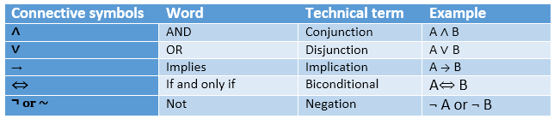
Following is the summarized table for Propositional Logic Connectives:

Slide 21
Truth Table:
In propositional logic, we need to know the truth values of propositions in all possible scenarios. We can combine all the possible combination with logical connectives, and the representation of these combinations in a tabular format is called Truth table. Following are the truth table for all logical connectives:

Slide 22
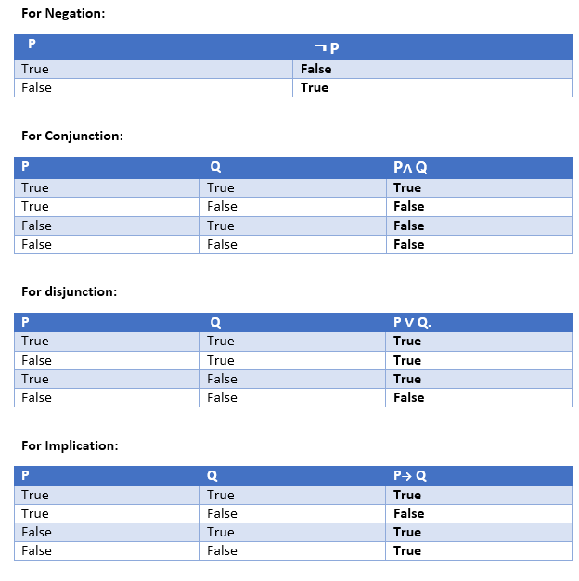

Slide 23
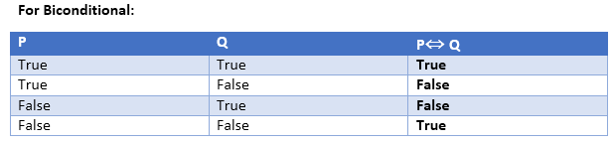
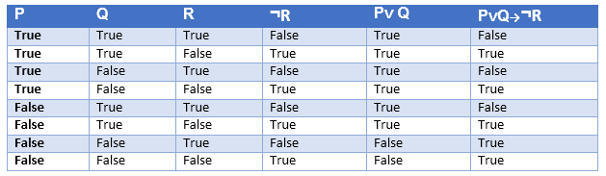
Truth table with three propositions: We can build a proposition composing three propositions P, Q, and R. This truth table is made-up of 8n Tuples as we have taken three proposition symbols.

Slide 24
Propositional Theorem Proving: Inference and proofs, Proof by resolution, Horn clauses and definite clauses.

Slide 25
Propostional Theorem Proving
Applying Rules on Inference directly to the sentences in our knowledge base to construct a proof of the desired a proof of the desired sentences without consulting models.
To build that sentences and satisfy then the logical equivalence and Inference Rules .
Logical Equivalence:- two sentences α and β are logically equivalent if they are true in the same set of models.
α = β
Eg:- P ∧Q = Q∧ P

Slide 26
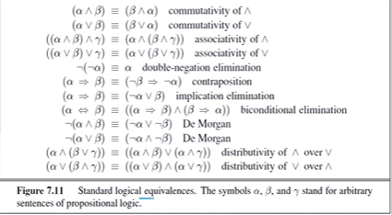

Slide 27
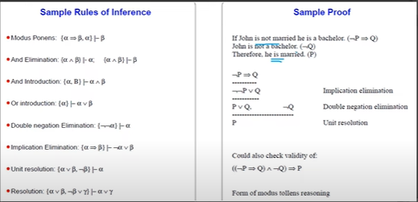
Inference and Proof’s

Slide 28
Horn clauses and definite clauses
Horn clauses are a specific form of logic clause used in knowledge representation. They are named after the logician Alfred Horn, who first defined them. A Horn clause is a logical formula of the form:
p1 ∧ p2 ∧ ... ∧ pn → q
Here, p1, p2, ..., pn are literals (propositional variables or their negations), and q is a single literal.
There are two types of Horn clauses:
Definite Horn Clauses: These are Horn clauses where n = 1. In other words, there is only one positive literal on the left-hand side of the implication. Example: p → q.
Horn Clauses in General: These are Horn clauses where n ≤ 1. In other words, there can be zero or one positive literal(s) on the left-hand side of the implication.

Slide 29
Horn clauses are particularly useful in logic programming and artificial intelligence because they are easy to reason about and can be efficiently evaluated.
Definite Clauses:
Definite clauses are a broader concept than Horn clauses. A definite clause is a logical formula that consists of a head and a body. It is of the form:
H ← B1, B2, ..., Bn
Here, H is the head, which is a single literal, and B1, B2, ..., Bn are the body, which consists of zero or more literals.
Definite clauses include Horn clauses as a special case when there is only one literal in the body. However, definite clauses are more general because they can have multiple literals in the body.
In summary, Horn clauses are a specific type of definite clause where there are restrictions on the number of literals in the body, making them particularly simple and efficient for certain types of logical reasoning.

Slide 30
First-Order Logic in Artificial intelligence
In the topic of Propositional logic, we have seen that how to represent statements using propositional logic. But unfortunately, in propositional logic, we can only represent the facts, which are either true or false. PL is not sufficient to represent the complex sentences or natural language statements. The propositional logic has very limited expressive power. Consider the following sentence, which we cannot represent using PL logic.
"Some humans are intelligent", or
"Sachin likes cricket."
To represent the above statements, PL logic is not sufficient, so we required some more powerful logic, such as first-order logic.

Slide 31
First-Order logic:
First-order logic is another way of knowledge representation in artificial intelligence. It is an extension to propositional logic.
FOL is sufficiently expressive to represent the natural language statements in a concise way.
First-order logic is also known as Predicate logic or First-order predicate logic. First-order logic is a powerful language that develops information about the objects in a more easy way and can also express the relationship between those objects.
First-order logic (like natural language) does not only assume that the world contains facts like propositional logic but also assumes the following things in the world:
Objects: A, B, people, numbers, colors, wars, theories, squares, pits, wumpus, ......
Relations: It can be unary relation such as: red, round, is adjacent, or n-any relation such as: the sister of, brother of, has color, comes between
Function: Father of, best friend, third inning of, end of, ......

Slide 32
As a natural language, first-order logic also has two main parts:
Syntax
Semantics
Syntax of First-Order logic:
The syntax of FOL determines which collection of symbols is a logical expression in first-order logic. The basic syntactic elements of first-order logic are symbols. We write statements in short-hand notation in FOL.

